Slide 1
Phase Noise Compensation Current implementation 2019.1.20

Slide 2
Outline
Theory (look ahead long division)
Circuit profile
Timing profile
Implementation alalysis
Notes & further optimization

Slide 3
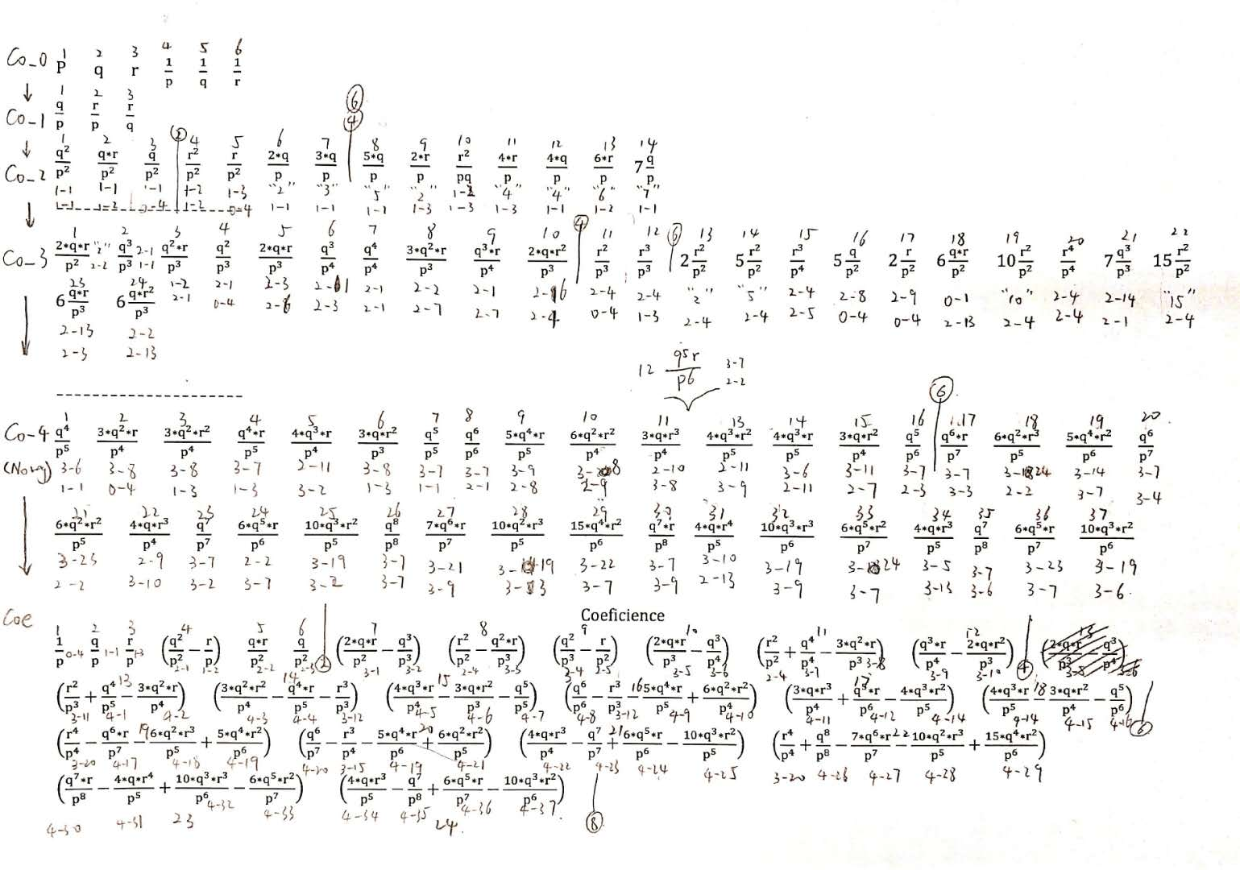
Theory (look ahead long division)

Slide 4
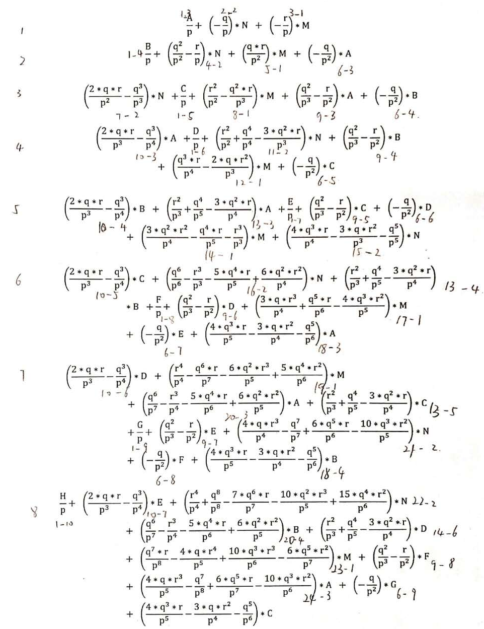

Slide 5
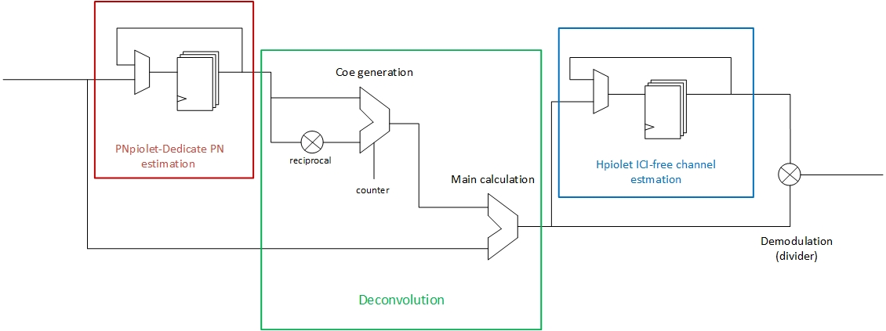
Circuit profile

Slide 6
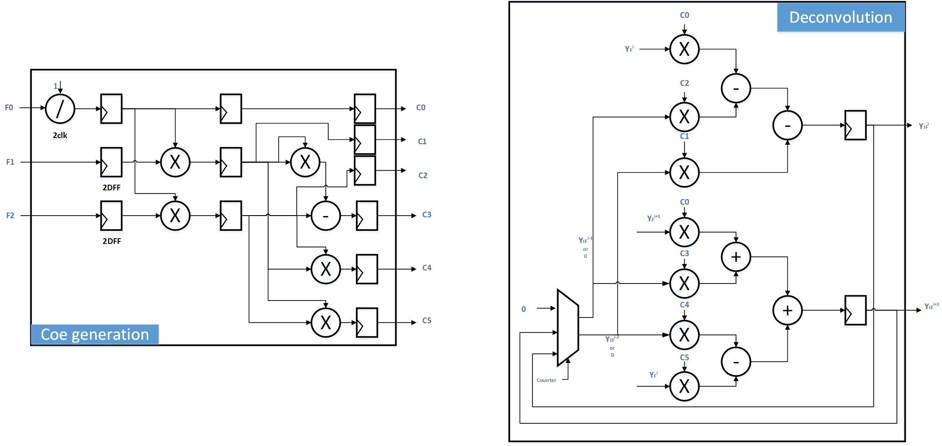
Circuit profile

Slide 7
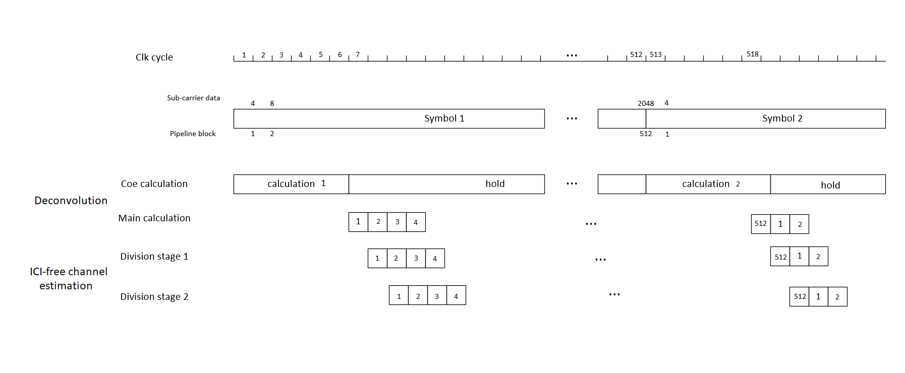
Timing profile (4 parallel)

Slide 8
Implementation Analysis
Vivado 2016.1
Xlinx Xc7a100tcsg324-1
Default sysnthesis and implementation settings

Slide 9
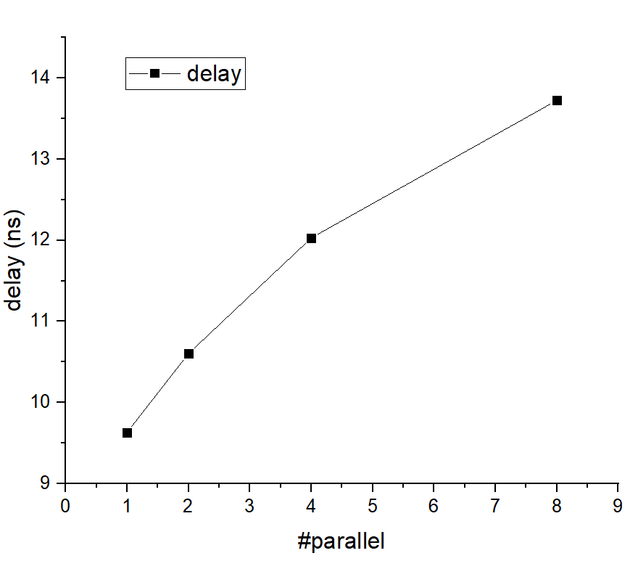
Implementation Analysis – clk preq

Slide 10
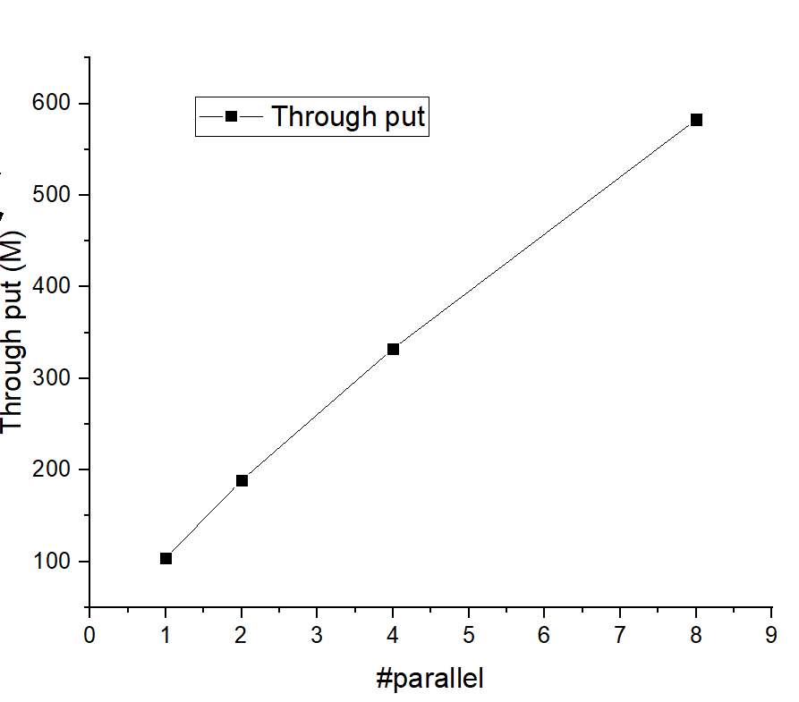
Implementation Analysis – throughput

Slide 11
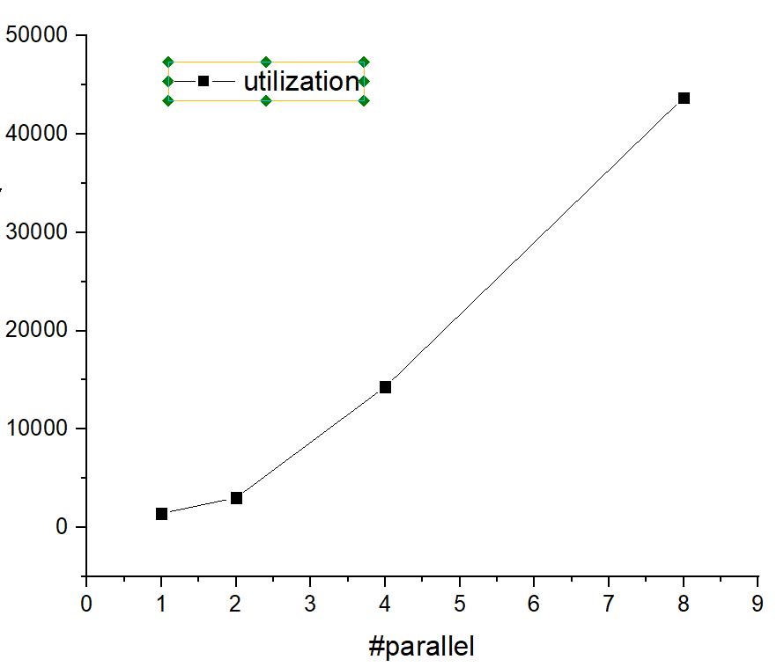
Implementation Analysis – utilization

Slide 12
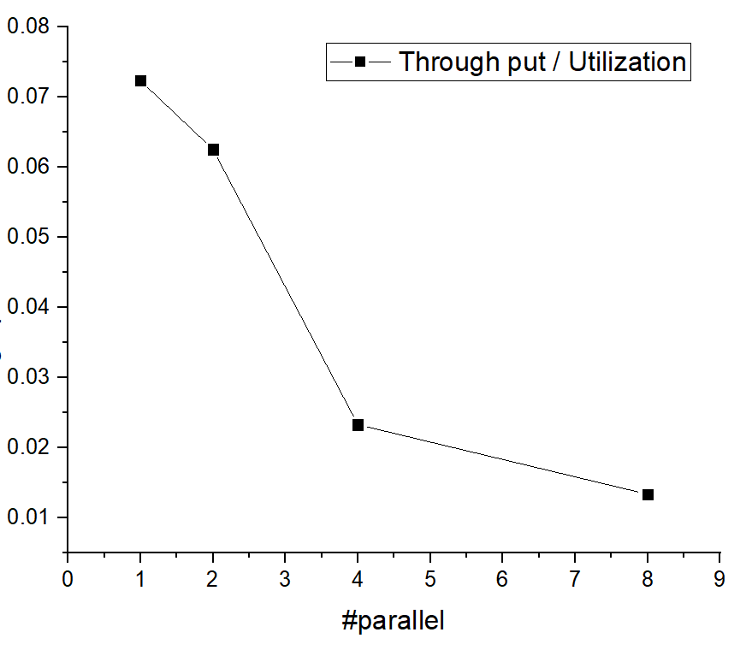
Implementation Analysis – through put / Utilization

Slide 13
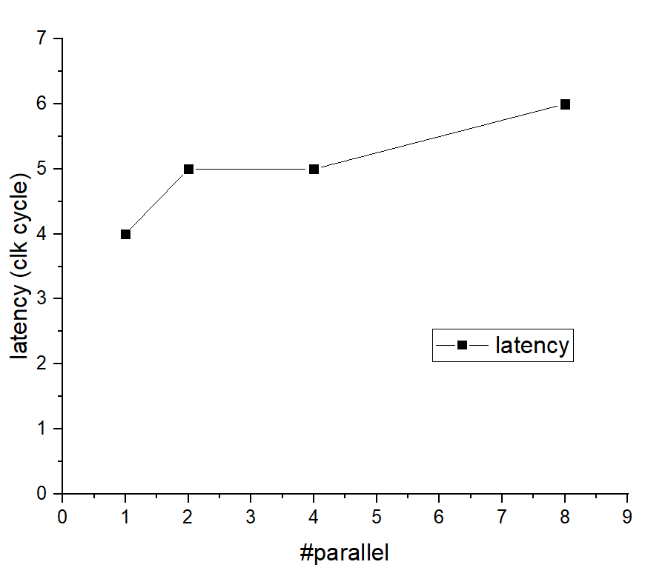
Implementation Analysis – latency
It takes 2 clk cycle for #1 to obtain useful piolet observation
(p,q . R is not used for coe)
2clk cycles for #2 too
7 clk cycles lentancy for #9 #10 (will be a huge work for implementation)

Slide 14
Implementation Analysis – critical path
# parallel | 1 | 2 | 4 | 8
Critical path | 1 LUT 1 MUL 2 ADD | 1 LUT 1 MUL 2 ADD | 1 LUT 1 MUL 3ADD | 1 LUT 1 MUL 4 ADD
*MUL: complex un-pipelined multiplier
# parallel | 10 | 12 | 14 | 16
Critical path | 1 LUT 1 MUL 4 ADD | 1 LUT 1 MUL 4 ADD | 1 LUT 1 MUL 4 ADD | 1 LUT 1 MUL 5 ADD

Slide 15
Implementation result – ASIC syns

Slide 16
Notes
The project do not support simulation, re-sysn and re-implementation (the test dedicated code has been removed)
Input:
complex_vector, Pf, #parallel of complex per clk cycle
Output:
complex_vector, xf, #parallel of complex per clk cycle
Quantization bits: 8, signed(8 downto 0) [could change universially]
Calculation range: -256 to 255
(haven’t done optimization for coe charactor, preferably pre-process befor entering this design)
N = 2048; Np = 3; Ncb = 4 [could not change universially]

